Slide 1
Lecture 3 Considerations for choosing cutoffs for seropositivity
May 22, 2025
Seroanalytics Training Blantyre, Malawi

Slide 2
Lecture outline:
Data visualization
Why binarize data?
Converting from MFI to IU/ml using a standard curve
Calculating seroprevalence from a cutoff
Selecting controls
How to choose a cutoff method?
Notes:
Now that we’ve completed the pre-processing step of the data, we will focus today on starting to draw inferences from our data, namely in ways to find seroprevalence.
Before that, let’s first look at our sample data.
Its important to visually inspect your data to determine if there is anything unusual before you get started applying equations

Slide 3
Visualizing data with histograms
How would you compare the different distributions of data?

Slide 4
Visualizing data with histograms
How would you compare the different distributions of data?
Normal vs. not normal distributions
Unimodal vs. bimodal vs. multimodal
Narrow or wide distribution
Outliers?
Notes:
Useful to look at overall distribution, see if there are patterns. Is there one peak or multiple peaks? Narrow or wide distribution?
Also do common sense checks – strange outliers

Slide 5
Visualizing data with histograms
What underlying differences might cause the different distributions of data?

Slide 6
Visualizing data with histograms
What underlying differences might cause the different distributions of data?
Mix of exposed and unexposed in population
Mix of vaccinated / unvaccinated
Notes:
What exposure patterns could lead to what distributions?
Could see a bimodal distribution if there is a mix of exposed and unexposed in population
Could see unimodal distribution if most people get exposed but have waning antibodies, or if exposure without symptomatic infection could lead to smaller immune response. Does vaccine vs. natural infection elicit different responses?

Slide 7
Measles histogram
How to get information from histograms like this?
How to compare the results of different histograms?
What inferences can we make about disease exposure based on a histogram?
A method of making inferences from distributions is binarizing data
Setting an MFI cutoff, and everything above that cutoff is positive
Notes:
Motivation and discuss how binarizing data can be useful to interpret a lot of information (5 min):
Example of Histogram of MFI from Measles
Show multiple histograms together. How to synthesize lots of information at once? How to compare overall histograms?
Easier to look at information if binarize it

Slide 8
Measles histogram
Measles has a correlate of protection
Individuals with antibody responses above a certain cutoff are expected to have neutralizing antibodies to measles
By applying a cutoff equivalent to the correlate of protection, we can calculate seroprevalence
In this case, seroprevalence is the proportion of people who are protected from getting measles disease
Notes:
Motivation and discuss how binarizing data can be useful to interpret a lot of information (5 min):
Example of Histogram of MFI from Measles
Show multiple histograms together. How to synthesize lots of information at once? How to compare overall histograms?
Easier to look at information if binarize it

Slide 9
Measles histogram
Measles correlate of protection is 120 mIU/ml (International Units per milliliter) of measles-specific IgG
However, the multiplex assay gives us units in MFI (median fluorescence intensity)
We can convert between mIU/ml and MFI using a standard curve, to calculate a correlate of protection in MFI
Notes:
Motivation and discuss how binarizing data can be useful to interpret a lot of information (5 min):
Example of Histogram of MFI from Measles
Show multiple histograms together. How to synthesize lots of information at once? How to compare overall histograms?
Easier to look at information if binarize it

Slide 10
Standard curves
The standard curve is created using known concentrations of antibody standards, measured on the same plate as the unknown samples.
First we fit a model to our data to establish the relationship between MFI values and known IU/mL concentrations.
Then we can use this model to convert the 120 mIU/ml correlate of protection to an equivalent MFI (or can convert MFI to values in mIU/ml)
Notes:
Example with measles- well-defined correlate of protection (15 min, with students putting in code as well)
Easy to justify using cutoff when there is a correlate of protection
To get MFI, we must use standard curve to convert international units to MFI.
To convert this, we need to use standards from controls samples that were tested at different known concentrations that will have different UIs. From this, we can convert the standardized UI to an MFI value that we can compare to our data.
The standard curve is created using known concentrations of antibody standards, measured on the same plate as the unknown samples.
First we fit a model to our data to establish the relationship between MFI values and known IU/mL concentrations.
Chatgpt prompt: in the same style as you did previously, write a section describing how to use the results of a standard curve. Standard curve is on a plate with results as MFI values from a multiplex bead assay. I want to use results from a standard curve to then convert international units to mfi to determine the cutoffs in a serological surveillance study.

Slide 11
R example – going from UI to MFI with std curve
R Code Demo: Fitting a 4PL Model for Standard Curve <- redo this in base R
library(drc) # Load package for dose-response curves
# Fit and Visualize the standard curve
standard_curve <- drm(IU_mL ~ MFI, data = standard_data, fct = LL.4())
plot(standard_curve, log = "x", xlab = "MFI", ylab = "IU/mL")
Then, since we know the UI for measles is XX, we convert this to MFI:
Insert code: dat$IU_mL <- predict(standard_curve, UI_value)

Slide 12
R code -
Applying cutoff
Go through r code of how to use MFI value to establish cutoffs
Ifelse() is baser mfi <- c(1, 5, 10)
Seropositivity <- ifelse(x > 5, 1, 0 )
Explain how this function treats mfi variable as a vector to apply statement to each item in vector
Then show results and go through code like:
table(Seropositivity) or table(Seropositivity,useNA="always")
round(prop.table(table(Seropositivity,useNA="always")),3)*100
plot cutoff on histogram

Slide 13
Question: How do we interpret seropositivity?
Also, how does our interpretation of seroprevalance for measles differ from seroprevalence NOT determined from a correlate of protection?
Notes:
Interpretation of these numbers: ask participants what they think (5-10 min with discussion)
Percentage of people who have been exposed to vaccine or natural infection
How might interpretation change based on what we know about measles spread in region and spread of vaccination (eg, if there’s no/little vaccination in area, we could interpret seroprevalence as indication of spread of disease, and if there’s little evidence of disease in area, this is more indication of vaccination
Cutoff is correlate as protection, so could also show which individuals are susceptible to future infection, and whether there could be outbreaks in region

Slide 14
Question: How do we interpret seropositivity?
Interpretation strongly depends on how seropositivity is determined, including controls used. Possible interpretations:
Percentage of people who have been exposed to vaccine or natural infection
How might interpretation change based on what we know about measles spread in region and spread of vaccination (eg, if there’s no/little vaccination in area, we could interpret seroprevalence as indication of spread of disease, and if there’s little evidence of disease in area, this is more indication of vaccination
Cutoff is correlate as protection, so could also show which individuals are susceptible to future infection, and whether there could be outbreaks in region
Notes:
Interpretation of these numbers: ask participants what they think (5-10 min with discussion)
Percentage of people who have been exposed to vaccine or natural infection
How might interpretation change based on what we know about measles spread in region and spread of vaccination (eg, if there’s no/little vaccination in area, we could interpret seroprevalence as indication of spread of disease, and if there’s little evidence of disease in area, this is more indication of vaccination
Cutoff is correlate as protection, so could also show which individuals are susceptible to future infection, and whether there could be outbreaks in region

Slide 15
Controls
If we don’t have a correlate of protection, we can use controls to determine cutoffs for seropositivity
Ideally, we could have positive and negative controls.
Often, we only have negative controls, and sometimes we don’t have positive or negative controls
The controls we use to establish cutoffs can affect our interpretation of seropositivity
Notes:
Controls necessary for many cutoff methods (15 min)
For most diseases, we don’t have a correlate of protection
Seropositivity using different cutoffs may have different interpretations. Consider how to interpret seropositivity for the cutoff methods you apply.

Slide 16
Positive controls
Often, positive controls are based on antibody responses from people who have the disease with specified antigens.
How might these positive controls differ from positives in samples?

Slide 17
Positive controls
Often, positive controls are based on antibody responses from people who have the disease with specified antigens.
How might these positive controls differ from positives in samples?
Vaccination vs. natural infection
Intensity of infection – severe, symptomatic, asymptomatic – (controls may be more likely to be severe, eg those needing treatment in a hospital)
Timing since infection (controls likely had acute infection, kinetics of responses are important)

Slide 18
Negative controls
What populations might be best to get negative controls from?

Slide 19
Negative controls
What populations might be best to get negative controls from?
Non-endemic area (likely to be adults)
Very young presumed unexposed (likely to be from target population)
What would be advantage or disadvantage of having controls from each of these populations?

Slide 20
Negative controls
What populations might be best to get negative controls from?
Non-endemic area (likely to be adults)
Very young presumed unexposed (likely to be from target population)
What would be advantage or disadvantage of having controls from each of these populations?
Controls from non-endemic area may differ from target population in many ways (geographic, socioeconomic, disease history)
Very young immune systems vs. adult immune systems

Slide 21
Negative controls
What populations might be best to get negative controls from?
Non-endemic area (likely to be adults)
Very young presumed unexposed (likely to be from target population)
What would be advantage or disadvantage of having controls from each of these populations?
Controls from non-endemic area may differ from target population in many ways (geographic, socioeconomic, disease history)
Very young immune systems vs. adult immune systems
Notes:
Ask trainees: What populations might be best to get negative controls from?
Non-endemic area (likely to be adults)
Very young presumed unexposed (likely to be from target population)
Discusses pros/cons of each of these. Idea that controls should be most similar to counterfactual exposed population that is otherwise exactly the same
In practice, you may not have ideal controls and will make do with what you have

Slide 22
Controls
You may not have ideal controls.
You should understand the assumptions/ biases of your controls

Slide 23
Cutoff methods
There isn’t always a clear answer for how to chose cutoff methods
Today we will go through 4 methods for determining cutoff methods:
International standard like correlate of protection
Using Receiver Operating Characteristic Curve (ROC, based on sensitivity and specificity, using both positive and negative controls
Unexposed population – depends on negative controls
Finite mixture model (FMM) – only based on sample results
Notes:
We are going to go through other cutoff methods today, and there isn’ t always a clear cut answer for how to choose the method. It can depend on what controls you have available. Today we’ll focus on 4 methods:

Slide 24

Examples of choosing cutoff methods
Serosurveillance of viral and vaccine preventable diseases using 47-plex assay
Notes:
https://www.medrxiv.org/content/10.1101/2024.04.26.24306413v1
Investigation of the sero-epidemiology of vaccine preventable diseases and common viral infections in French populations using a multiplex serological assay

Slide 25
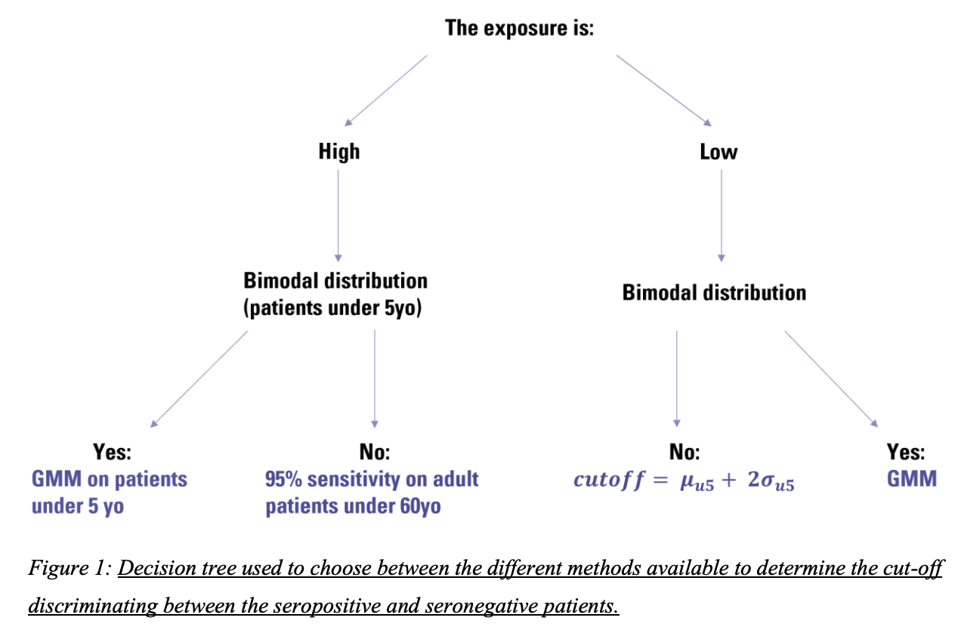
Examples of choosing cutoff methods
Bloch et al. Investigation of the sero-epidemiology of vaccine preventable diseases and common viral infections in French populations using a multiplex serological assay. 2024. medRxiv.
Notes:
https://www.medrxiv.org/content/10.1101/2024.04.26.24306413v1
Investigation of the sero-epidemiology of vaccine preventable diseases and common viral infections in French populations using a multiplex serological assay

Slide 26
Choosing cutoff methods: Example from Zambezia, Mozambique panel
Controls | Methodology | Pick cutoff that
Availability of international standards | Translation of values to international units | Corresponds to known correlates of protection
Availability of both positive and negative controls | Receiver Operating Curve | Maximize Youden’s J
If sensitivity is lower than desired | Receiver Operating Curve with floor value for sensitivity | Maximum specificity possible with sensitivity of at least 75%
If sensitivity, specificity, or seroprevalence do not seem reasonable | Receiver Operating Curve | Select cutoff to match previous estimates
Availability of only negative controls | Sample mean plus 3 standard deviations | Sample mean plus 3 standard deviations
If controls are not normally distributed or have small number of controls | Highest negative control
If negative controls have some high values that seem to fit a bimodal distribution | Finite mixture model (2-component model with Gaussian distributions) | Sample mean plus 3 standard deviations on the logarithmic scale
No controls available | Finite mixture model | Calculated from full distribution of study results

Slide 27
Other considerations:
You may want to set up a way to decide cutoffs like the previous papers, or decide based on how the distributions look (of controls or samples), what you know about the controls, whether to prioritize minimizing false negatives vs false positives, or what the seropositivity interpretation should be
This afternoon we will go through different methods of determining cutoffs

Slide 28
Lab 3
Note: Trainees should use the data from their own experiment when possible. If methods are not possible (ie because of the lack of controls or standard curve etc), then trainees should use the extra dataset available. Do the following for one of your antigens. If time, repeat for additional antigens.
Make a histogram of sample MFI values.
Consider how many bins to use.
Describe the distribution.
Are there any outliers or anything unusual about your data.
Make a histogram of control MFI values. Color the histogram by positive and negative controls
What is the source of your controls? How would using these controls to establish a cutoff affect your interpretation of seroprevalence for this antigen?
For an antigen with an established standard cutoff:
Use standard curve to convert IU to MFI for antigen with UI.
Apply cutoff. Show number and % seropositive.
To histogram of sample MFI values, add a vertical line showing the cutoff
For this specific antigen, how would you interpret this seropositivity?
What do you think about using this cutoff method for this antigen? What are the assumptions that went into this cutoff method?

